Slide 1
Ethics Training 2022
A Course for Elected & Appointed Officials, Board Members, Employees and Volunteers

Slide 2
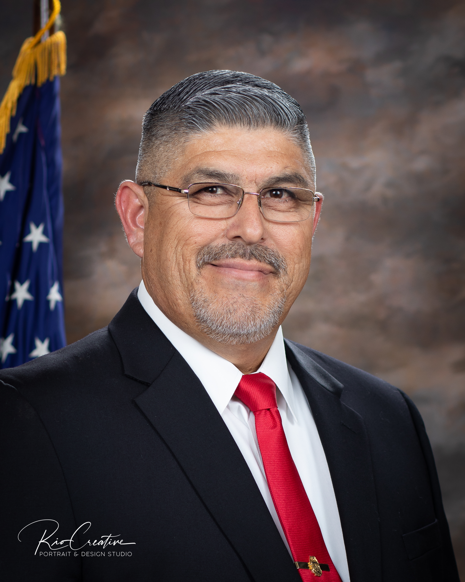
La Joya City Council
Isidro Casanova
Mayor
Laura Mendiola Macias
Angie Garza
Chuck Garza
Roger Hernandez
Mayor Pro Tempore
Councilwoman
Councilman
Councilman

Slide 3
Department Directors
Leonardo Olivares Interim City Manager
Vanessa Trevino Interim City Secretary
Roberto Jackson City Attorney
Gregoria Jackson Finance
Ismael Garza Interim Fire Chief
Susana Villegas Library
Lee Roy Alaniz Municipal Court
Rosie Trevino Personnel
Ramon Gonzalez Police Chief
Fernando Botello Planning/Code Enforcement
Omar Peralez Parks & Recreation
Cesar Alanis Interim Public Works
Isidro Venecia Public Utilities

Slide 4
Contents
Introduction
Texas Statutes
Municipal Charter
Personnel Policies
Purchasing Policies
State
Local
Summary

Slide 5
1. Introduction
Ethics Ordinance #2021-06

Slide 6
Ethics Ordinance 2021-06
Required by Municipal Charter
Basics training for everyone within 90 days
Screening of all board members
Ethics Advisory Board established
Biennial review of Ethics Ordinance
Penalties
$75 for Elected Officials
Discipline for Employees
Removal for Volunteers

Slide 7
Ethics Ordinance 2021-06
Individuals | Ethics Training | Hours
Elected Officials | Texas Statutes Municipal Charter Personnel Policies Purchasing Policies | 8.0
Appointed Officials | Texas Statutes Municipal Charter Personnel Policies Purchasing Policies | 8.0
Board Members | Texas Statutes Municipal Charter | 4.0
Employees | Municipal Charter Personnel Policies | 4.0
Volunteers | Municipal Charter Personnel Policies | 2.0

Slide 8
2. Texas Statutes
Roberto Jackson, City Attorney

Slide 9
2. Texas Statutes
Introduction
Anti-Bribery Statement
Bribery & Corrupt Influence
Abuse of Office
Nepotism
Conflicts of Interest
Disclosure of Relationships with Government Officials
Texas Whistleblower Act
Summary

Slide 10
A. Anti-Bribery Statement
Texas Constitution, Article XVI, Section 1 as per
La Joya Home Rule Charter, Section 9.03

Slide 11
B. Bribery & Corrupt Influence
Penal Code, Chapter 36

Slide 12
C. Abuse of Office
Penal Code, Chapter 39

Slide 13
D. Nepotism
Government Code
Prohibitions
573.041: Appoint, Confirm, Vote … Directly/Indirectly Compensated
573.042: Candidate Appointment, Employment, Change in Status, Compensation, Dismissal
573.044: Trading appointments
573.062: Exception, Continuous Employment
Penalties
573.081: Removal
573.083: Withholding Payment
573.084: Criminal Penalty (Misdemeanor)

Slide 14
E. Conflicts of Interest
Local Government Code
171.001: Definitions
171.002: Substantial Interest in Business
Owns >10% voting stock
Owns >10% or >$15K fair market value
>10% gross income
171.003: Prohibition; Penalty
171.004: Affidavit & Abstention from Voting
171.005: Voting on Budget
171.006: Effect of Violation

Slide 15
E. Conflicts of Interest

Slide 16
E. Conflicts of Interest
Local Government Code
176.003: Disclosure Statement
176.006: Disclosure Questionnaire
176.0065: Maintenance of Records
176.009: Posting on Internet
176.013: Enforcement

Slide 17
G. Texas Whistleblower Act
Government Code
554.002: Retaliation Prohibited
No suspension or termination by City
For reporting City or employee
Person must report to law enforcement
554.003: Relief to Employee
Sue for injunctive relief, actual & compensatory damages, wages, benefits
554.008: Supervisor liable for $15K, paid by Supervisor, not City

Slide 18
Summary
Q&A

Slide 19
3. Municipal Charter
Leonardo Olivares, Interim City Manager

Slide 20
3. Municipal Charter
Introduction
Art I: Incorporated; Form of Government
Art II: Powers of the City
Art III: City Council
Art IV: City Administration
Art V: Financial Procedures
Art VI: Elections
Art VII: Initiative; Referendum; Recall
Art VIII: Franchises & Public Utilities
Art IX: General Provisions
Art X: Transitional Provisions
Art XI: Submission of Charter to Voters
Summary

Slide 21
3. Municipal Charter: Art 1
Incorporated; Form of Government
Preamble
1.01: Incorporation
1.02: Form of Government
Mayor-Council
Council-Manager
1.03: Boundaries

Slide 22
3. Municipal Charter: Art 2
Powers of the City
2.01: Powers of the City
2.02: Eminent Domain
2.03: Alteration & Extension of Boundaries
2.04: Annexation Procedures
A. Petition of Voters/Landowners
B. Involuntary
2.05 Disannexation

Slide 23
3. Municipal Charter: Art 3
City Council
3.01: General Powers & Duties
3.02: Qualifications
3.03: Composition; Eligibility, Elections & Terms
3.04: Mayor
3.05: Compensation; Expenses
3.06: Prohibitions
3.07: Vacancies, Forfeiture of Office; Filling of Vacancies
3.08: Judge of Qualifications
3.09: Investigations
3.10: Independent Audit

Slide 24
3. Municipal Charter: Art 3
City Council, Continued
3.11: Procedure
3.12: Action Requiring an Ordinance
3.13: Ordinance in General
3.14: Emergency Ordinances
3.15: Codes of Technical Regulations
3.16: Authentication & Recording: Codification; Printing

Slide 25
3. Municipal Charter: Art 4
City Administration
4.01: City Manager
4.02: Duties of the City Manager
4.03: City Secretary
4.04: City Attorney
4.05: Municipal Court
4.06: Bonds of City Employees

Slide 26
3. Municipal Charter: Art 5
Financial Procedures
5.01: Fiscal Year
5.02: Submission of Budget & Budget Message
5.03: Budget Message
5.04: Budget
5.05: City Council Action on Budget
5.06: Budget Amendments After Adoption
5.07: Lapse of Appropriations
5.08: Capital Program
5.09: Public Records
5.10: Purchase Procedures

Slide 27
3. Municipal Charter: Art 5
Financial Procedures, Continued
5.11: Accounting & Reporting Procedures
5.12: Authority to Issue Bonds
5.13: Authority to Levy Taxes
5.14: Collection of Taxes

Slide 28
3. Municipal Charter: Art 6
Elections
6.01: Regular Elections
6.02: Qualified Voters
6.03: Regulation of Elections
6.04: Filing for Office
6.05: Election by Majority
6.06: Prohibition

Slide 29
3. Municipal Charter: Art 7
Initiative; Referendum; & Recall

Slide 30
3. Municipal Charter: Art 8
Franchises & Public Utilities
8.01: Power to Grant Franchise
8.02: Franchise Extensions
8.03: Transfer of Franchise
8.04: Option to Purchase
8.05: Regulation Franchise
8.06: Franchise Records

Slide 31
3. Municipal Charter: Art 9
General Provisions
9.01: Conflict of Interest
9.02: Nepotism
9.03: Oath of Office
9.04: Planning & Zoning
9.05: Prohibition
9.06: Public Records
9.07: Claims Against the City
9.08: Liens, Assignments; Execution; & Garnishment
9.09: Severability & Translation
9.10: Charter Amendment

Slide 32
Summary
Q&A

Slide 33
4. Personnel Policies
Rosie Trevino, Personnel Director

Slide 34
4. Personnel Policies
Introduction
Employment
Employment Status & Records
Employee Benefit Programs
Time Keeping/Payroll
Work Conditions & Hours
Leaves of Absence
Employee Conduct & Disciplinary Action
Summary

Slide 35
100. Employment
Introduction
Employee Relations
Equal Employment Opportunity
Business Ethics & Conduct
Personal Relationships in the Workplace
Employee Medical Examinations
Immigration Law Compliance
Conflicts of Interest
[Black]
Outside Employment

Slide 36
100. Employment
[Blank]
Non-Disclosure
[Blank]
Disability Accommodation
[Blank]
Job Posting & Employment Referrals

Slide 37
200. Employment Status & Records
[Blank]
Access to Personnel Files
Employment Referral Checks
Personnel Data Changes
Introductory Period
[Blank]
[Blank]
Employment Applications
Performance Evaluations
Job Descriptions
[Blank]
Salary Administration

Slide 38
300. Employee Benefit Programs
[Blank]
[Blank]
Vacation
[Blank]
Holidays
Workers’ Compensation Insurance
Sick Leave
Time Off to Vote
Bereavement Leave
[Blank]
Jury Duty

Slide 39
400. Time Keeping/Payroll
Timekeeping
[Blank]
Paydays
[Blank]
Employment Termination
[Blank]
[Blank]
Pay Advances
Administrative Pay Corrections

Slide 40
500. Work Conditions & Hours
Safety
Work Schedules
[Blank]
Use of Phone & Mail Systems
Smoking
Rest & Meal Periods
Overtime
Use of Equipment & Vehicles
[Blank]
Emergency Closings

Slide 41
500. Work Conditions & Hours
[Blank]
Business Travel Expenses
[Blank]
Visitors in the Workplace
- 521. [Blank]
522. Workplace Violence Prevention

Slide 42
600. Leave of Absence
Medical Leave
Family Leave
Military Leave

Slide 43
700. Employee Conduct & Disciplinary Action
Employee Conduct & Work Rules
Drug & Alcohol Use
Sexual & Other Unlawful Harassment
Attendance & Punctuality
Personal Appearance
Return of Property
[Blank]
Resignation
- 711. [Blank]
712. Solicitation
713. [Blank]
714. Drug Testing

Slide 44
700. Employee Conduct & Disciplinary Action
[Blank]
Progressive Discipline
- 719. [Blank]
720. Casual Days
721. LJFD By-Laws

Slide 45
Summary
Q&A

Slide 46
5. Purchasing Policies
Goya Jackson, Finance Director

Slide 47
5. Purchasing Policies
Introduction
State Laws
Local Laws
Municipal Charter
Accounting Procedures
Purchasing Manual
Summary

Slide 48
A. State Laws
Introduction

Slide 49
B. Local Laws
Municipal Charter
Accounting Procedures
Purchasing Manual

Slide 50
B. Local Laws: Purchasing Manual
Introduction
Purchasing Ethics
Purchasing Process
Quotation Process
Bid Process
Emergency Purchases
Sole Source Purchases
Disposal of Surplus/Salvage Equipment/Material
Miscellaneous

Slide 51
B. Local Laws: Purchasing Manual
Introduction
Authority
Purchasing Division
Goals of These Policies & Procedures
Responsibilities of Employees
Purchasing Manual Overview

Slide 52
B. Local Laws: Purchasing Manual
Purchasing Ethics
Disclosure of Certain Relationships
Conflicts of Interest
Personal Gain
Disclosure of Certain Relationships
Influence of a Public Employee
Participation in Procurements with Family
Gratuities
Kickbacks
Confidential Information
Purchase of Materials, Equipment & Supplies for Personal Use
Private Purchase through City Facilities

Slide 53
B. Local Laws: Purchasing Manual
Purchasing Process
General Authority
Purchasing Limits & Requirements
Purchasing Requirements
Liabilities not Requiring Purchasing Orders
Purchase Order Process
Purchase Order Payment Process
Receiving & Inspection
Invoices

Slide 54
B. Local Laws: Purchasing Manual
Quotation Process – Formal/Informal

Slide 55
B. Local Laws: Purchasing Manual
Bid Process
Sealed Bid or Proposal Procedures
Requirements Under State Law
Advertising & Advertising Time Requirements
Bid Specifications & Department Requisitions
Bid Preparation & Administration
Bid Opening Procedures
Bid Recommendations & State Law Regarding Bid Awards
Bid Number Sequences
Bid Discrepancies & Disqualifications
Agenda Requirement Responsibilities
Release of Bid Information
Change Orders
Bonding
Insurance Requirements
Technology Competitive Sealed Proposals

Slide 56
B. Local Laws: Purchasing Manual
Emergency Purchases
Procedures for Making Emergency Purchases

Slide 57
B. Local Laws: Purchasing Manual
Sole Source Purchases
Procedures for Sole Source Purchases

Slide 58
B. Local Laws: Purchasing Manual
Disposal of Surplus/Salvage Equipment/Material
Surplus Equipment & Property
Salvage Material

Slide 59
B. Local Laws: Purchasing Manual
Miscellaneous
Sales Tax
Preference to Local Vendors
Purchasing through State Contracts
Purchases Other than Cooperative Purchasing Using Homeland Security Funds
Employee Reimbursements for City Expenses
Purchasing Laws

Slide 60
Summary
Q&A

Slide 61
6. Congratulations
You will receive a Certificate of Completion for Ethics Training

Slide 62
Thank You y Gracias!
CITYOFLAJOYA.COM

